Slide 1
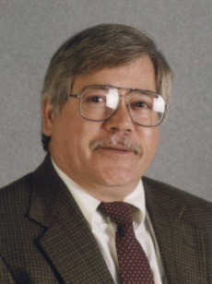


Mixing and Segregation of Biomass Particles in a Bubbling Fluidized Bed
Jack Halow, Benjamin Crawshaw
Waynesburg University
Stuart Daw, Charles Finney
Oak Ridge National Laboratory
Presented at the 2011 Fall National Meeting of the American Institute of Chemical Engineers
October 16-21, 2011
Minneapolis, Minnesota
Jack
Ben
Stuart
Charles

Slide 2
Objectives
Develop and demonstrate a unique experimental magnetic particle tracking system (MPTS) for studying mixing and segregation of simulated biomass particles in bubbling fluidized beds
Apply MPTS to characterize the statistics of simulated biomass particle motion in a laboratory bubbling bed
Propose a combined deterministic-stochastic model for biomass particle motion

Slide 3
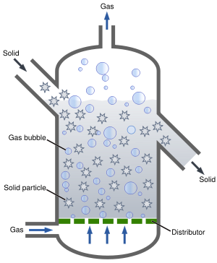
Background and Motivation: Many processes for generating power and fuels from biomass utilize fluidized bed reactors
Turbulent multi-phase flow
High heat and mass transfer
Small amount of biomass in bed of inert/catalytic particles (different from beds with more balanced particle mixtures)
Mixing of biomass particles with gas, other particles key to performance
Different size and density of biomass particles tend to promote segregation
Biomass particle properties change rapidly due to devolatilization, reaction

Slide 4
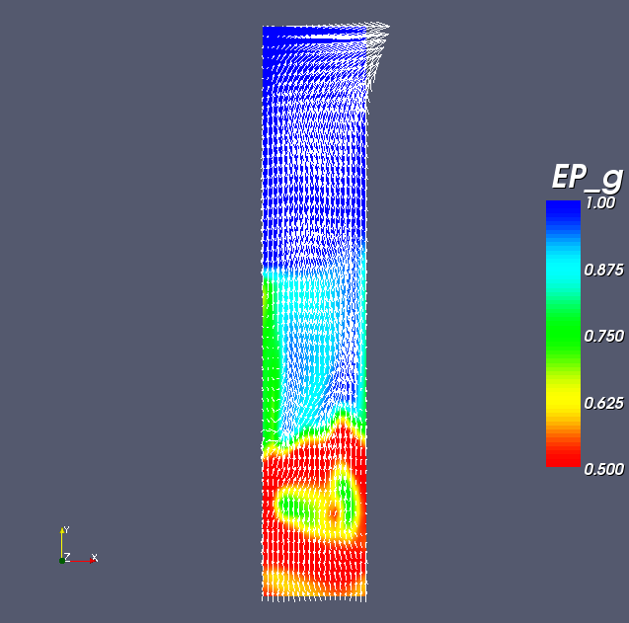
Fluidized bed reaction of biomass involves complex, multi-scale physics and chemistry
Biomass Particle
(small scale)
Fluidized Bed Reactor
(device scale)
a
Γ
a
a
Γ
Γ
Γ
r
b
radiation
p
Γ
z
Biomass particle
Γ
z
Gas phase
Gas phase
Gas flow in char
Gas flow in the char
0.1-1 mm particles
10-100 nm pores
0.1-1 ms reactions and transport
Pyrolysis front
Pyrolysis front
Unreacted biomass
Not yet reacted biomass
0.1-1 m bed depth, 0.1-10 m diameter
500-1000 °C
1-10 s gas residence times
Multiple spatial zones
Challenges:
  Controlling gas and solids mixing
  Maintaining optimal temperatures, species, residence times
  Selecting and tailoring catalyst properties
  Identifying and modeling all the relevant processes

Slide 5
Technical Approach
Adapt previously reported magnetic tracer system to investigate fluidization states relevant to laboratory biomass pyrolysis and gasification reactors
  5.5-cm diameter bed with porous distributor
  Beds of 200 micron glass beads and 100-200 micron sand
  Fluidized in bubbling regime (1<U/U_{mf}<6) with ambient air
  1-5 mm, 0.55-1.2 g/cc tracer particles with neodymium core
  Magneto-resistive probes near the top of the bed
Track motion of single tracer particles
  Record magnetic probe signals at .005 s intervals for 5 min
  Deconvolve signals to reconstruct 3D trajectories
Analyze trajectories for mixing and segregation patterns
  Time-average statistical distributions of position and velocity
  Dynamic models to simulate particle motion

Slide 6
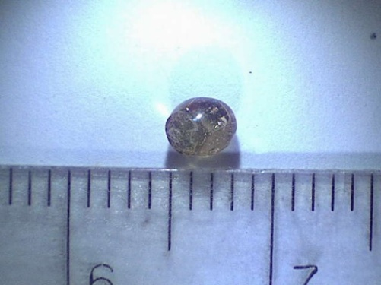
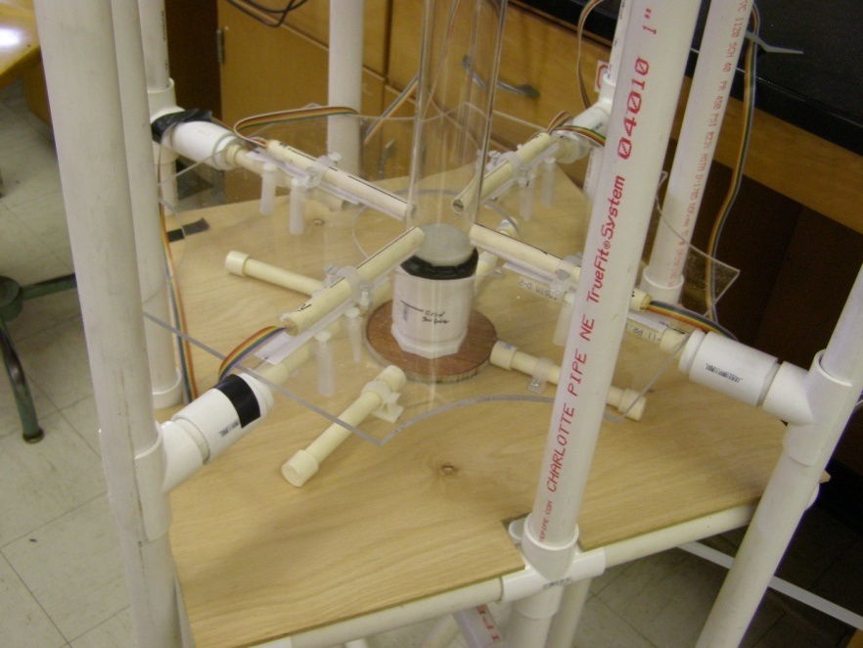
The magnetic particle tracking system experiments simulate biomass particle mixing
Simulated biomass (tracer) particles are constructed over a tiny neodymium magnet core
Foam coating is applied to form a sphere
Tracer particles 1-5 mm diameter, 0.55-1.2 g/cc
Fluidized Bed
Magnetic Probes
Single tracer particles are injected into a lab fluidized bed operating at fluidization states similar to experimental pyrolysis reactors
The magnetic probe signals are deconvolved to reconstruct the 3D tracer particle trajectory

Slide 7
Example Observations from Magnetic Particle Tracking
Experimental setup:
55 mm cylindrical bed
Bed solids, 177-250 micron glass spheres
Air fluidization, U_{mf} = 35 cm/s, 1.1<U/U_{mf}/6.0
½-inch porous polyethylene distributor
Slumped bed depth 55mm (L/D = 1)
4.4 mm tracer particles, 0.76-1.2 g/cc
  0.53-0.76 g/cc => grain, lighter woods, paper
  0.89 g/cc => rubber, leather, denser woods
  1.10-1.20 g/cc=> starch, wool, pelletized waste

Slide 8
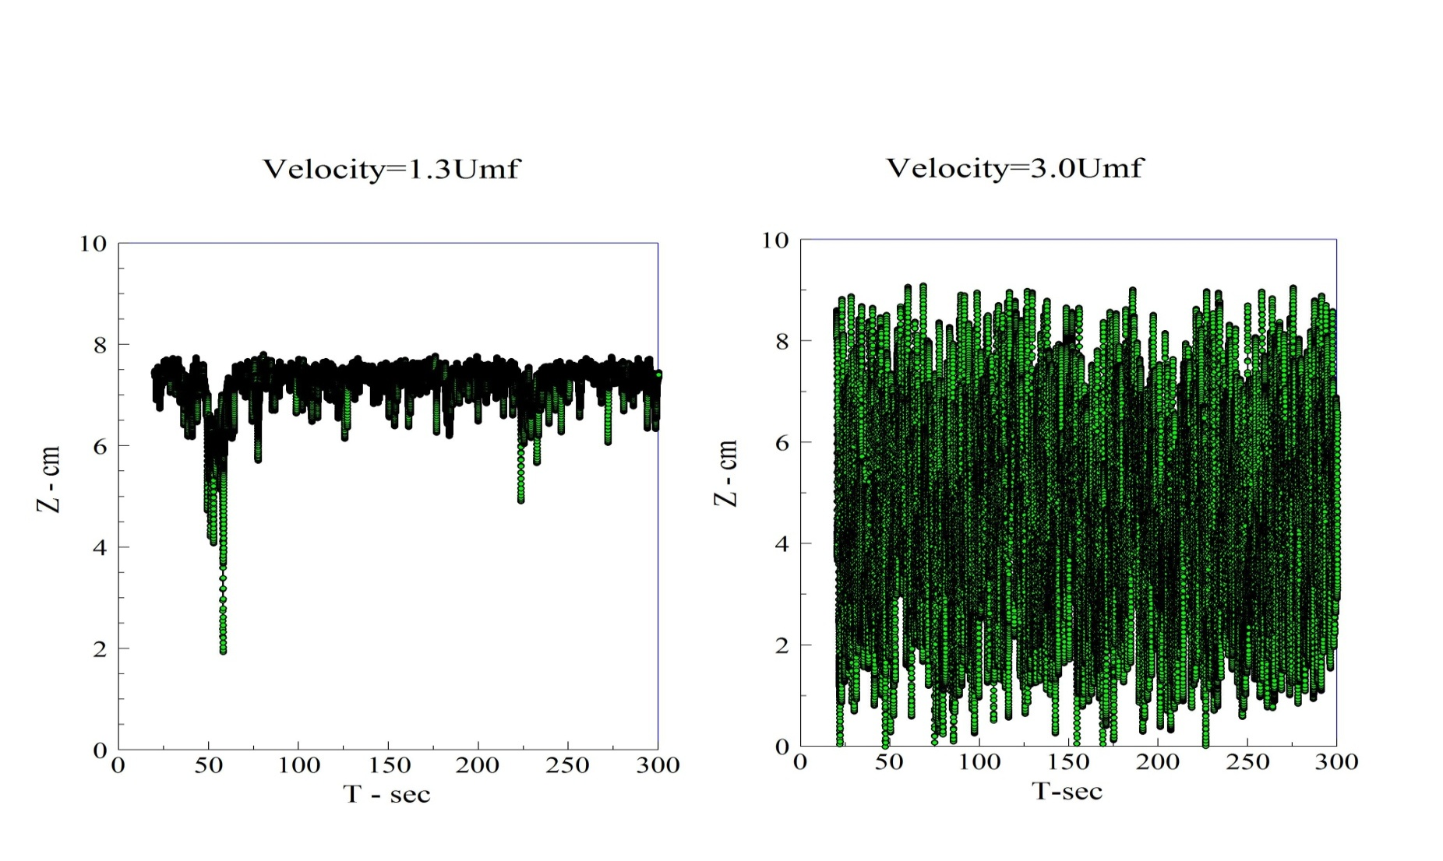
For lighter simulated biomass particles (0.76 g/cc) there is a strong segregation tendency at low air flows

Slide 9
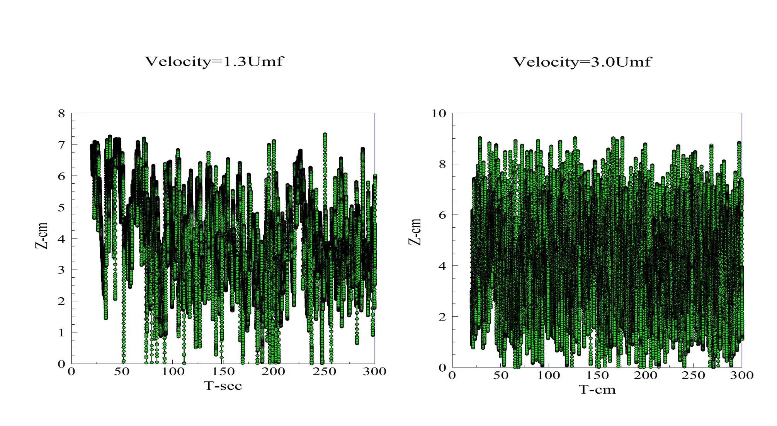
Particles with moderate density (0.89 g/cc) have only a slight tendency to segregate

Slide 10
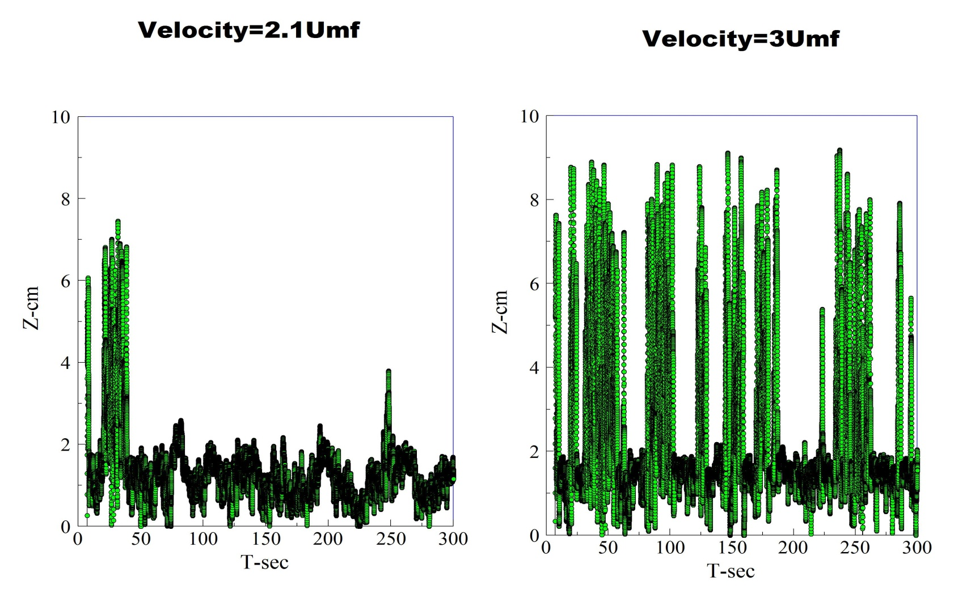
Heavier tracer particles (1.2 g/cc) tend to bottom segregate, even at higher air flows

Slide 11
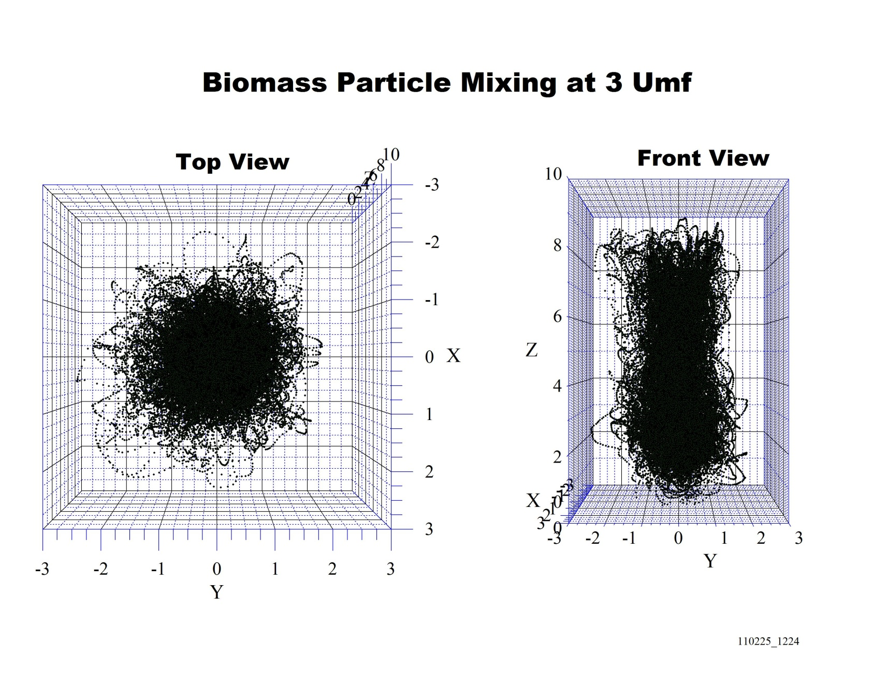
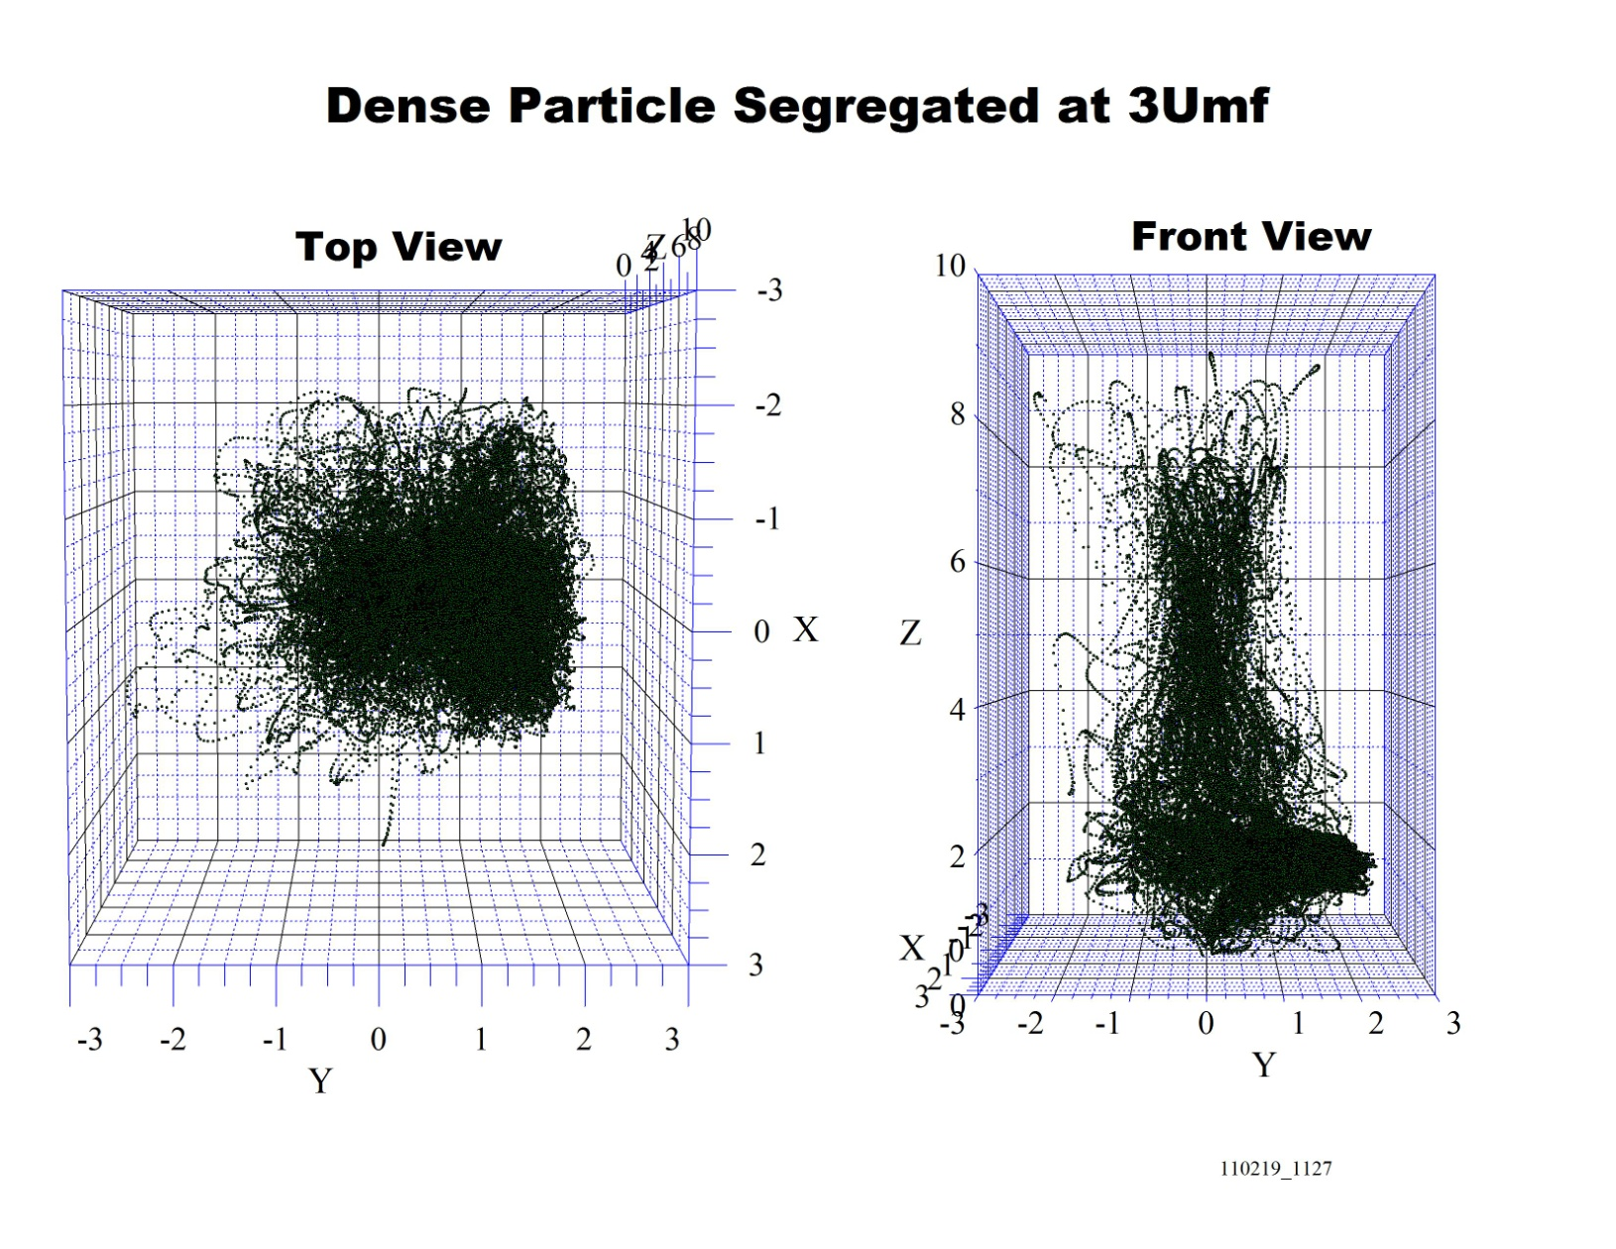
Lateral shifts in the trajectories are also revealed by magnetic tracking
0.76 g/cc particle, U/U_{mf}=3
1.20 g/cc particle, U/U_{mf}=3

Slide 12
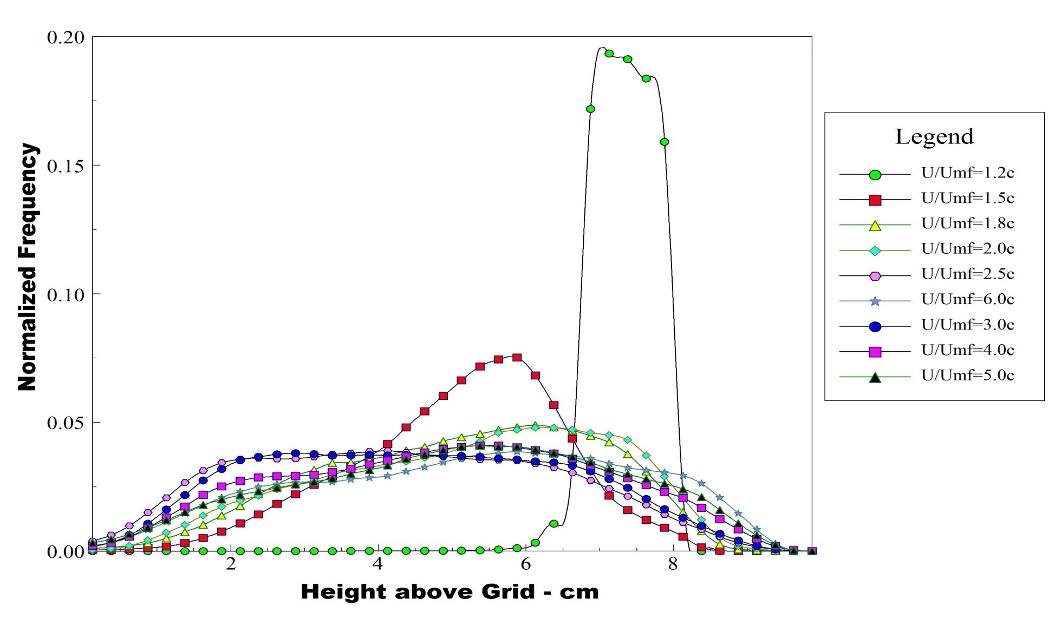
Time average axial pdfs for the light (0.76 g/cc) tracer particle reveal a shift from top-segregating to more mixed behavior
Note end effects

Slide 13
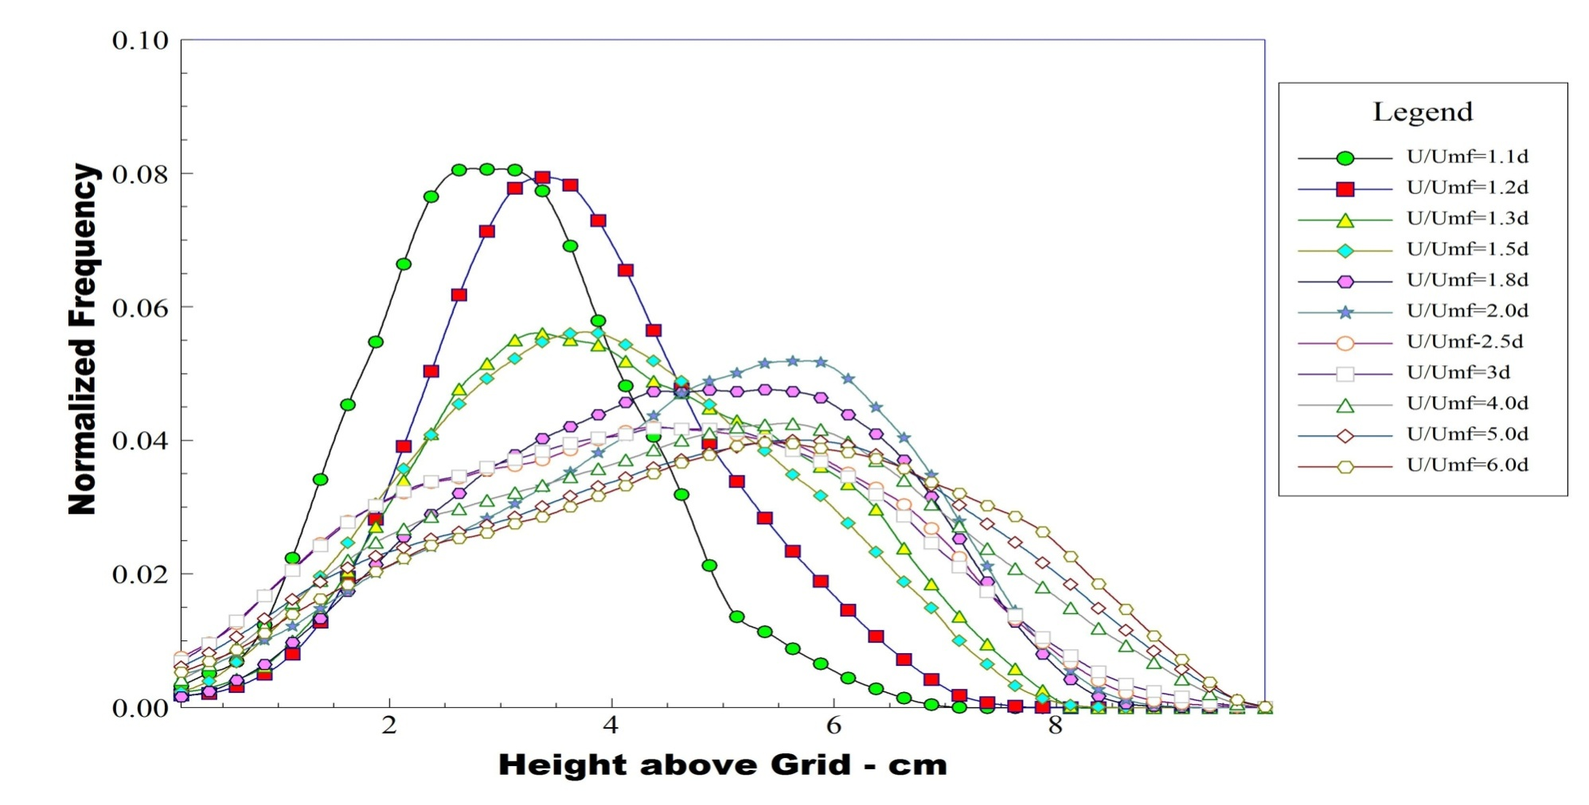
The time-average axial pdf for the moderate density tracer (0.89 g/cc) reveals a shift from slightly bottom-segregated to slightly top-segregated

Slide 14
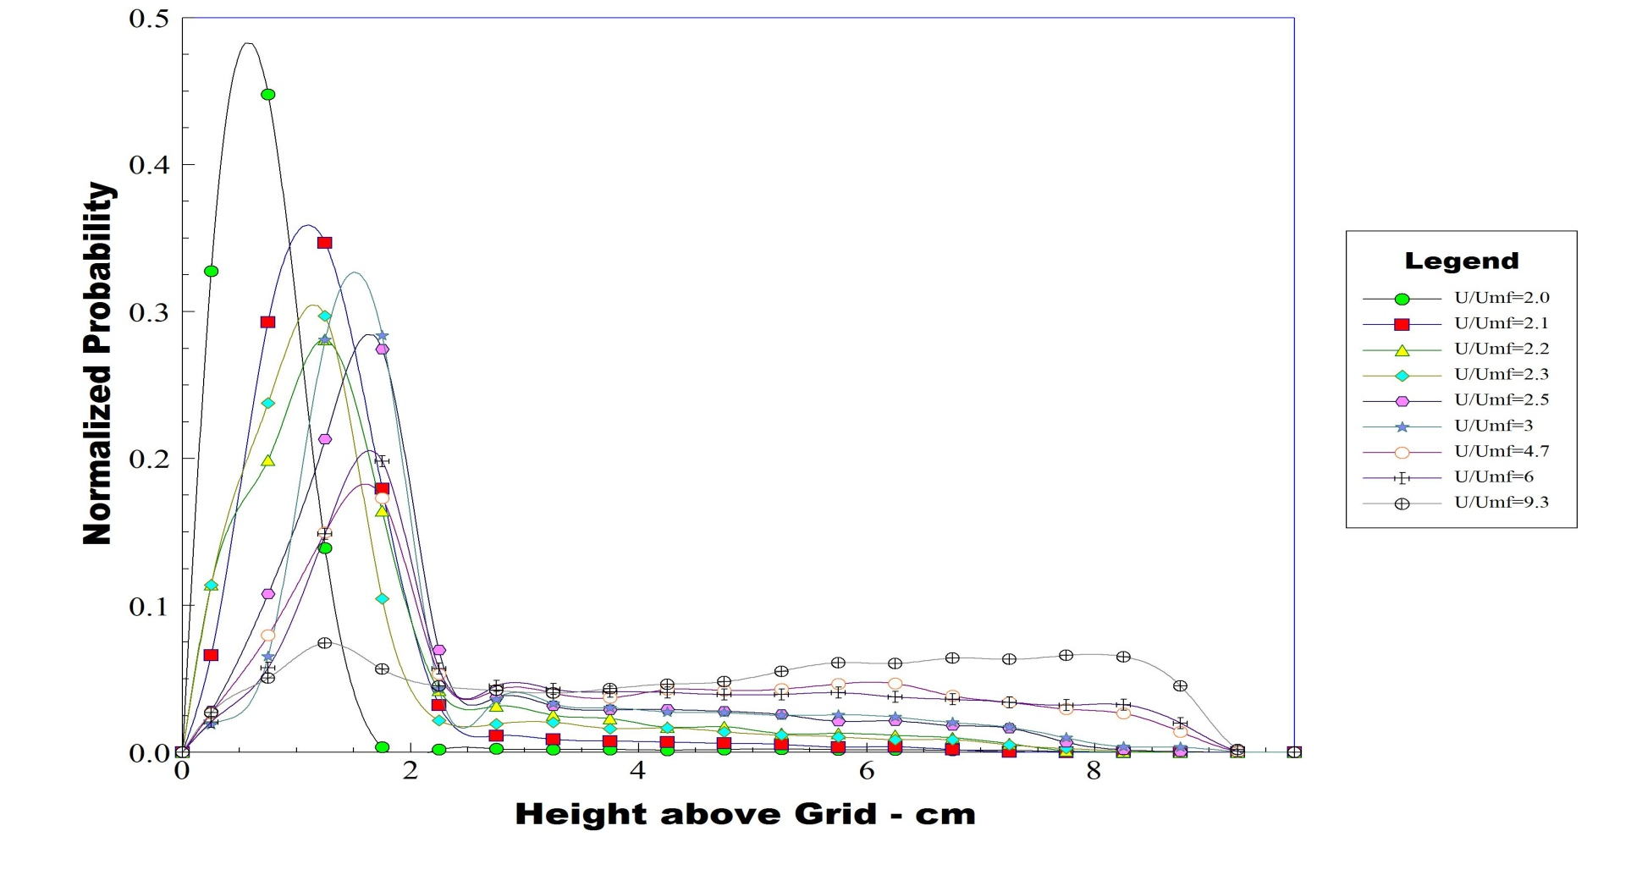
The time average axial pdf for the heaviest particle (1.2 g/cc) stays bottom- segregated for all air flows

Slide 15
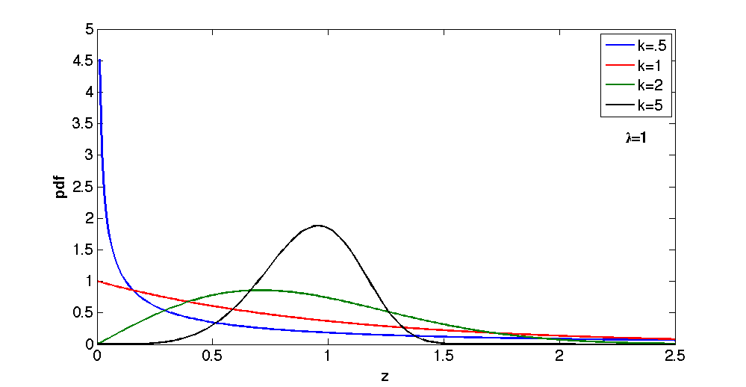
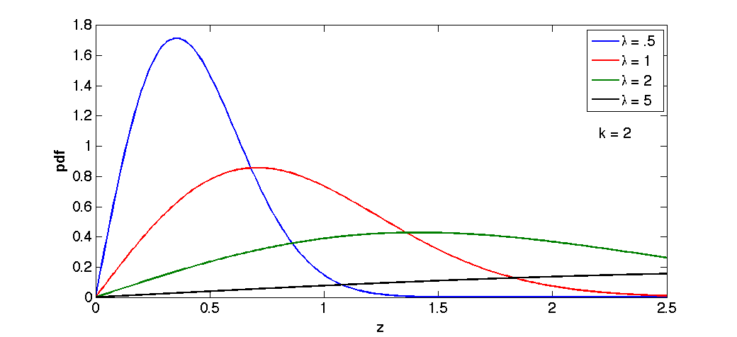
It appears that axial tracer pdfs can be approximated by a Weibull distribution
k>0 is a shape parameter, λ>0 is a scale parameter, z>0
Widely used: Life sciences, meteorology, economics, hydrology, engineering
Related to other distributions: Rayleigh, Exponential, Maxwell-Boltzmann
See The Weibull Distribution: A Handbook by Horst Rinne, 2009, Taylor & Francis

Slide 16
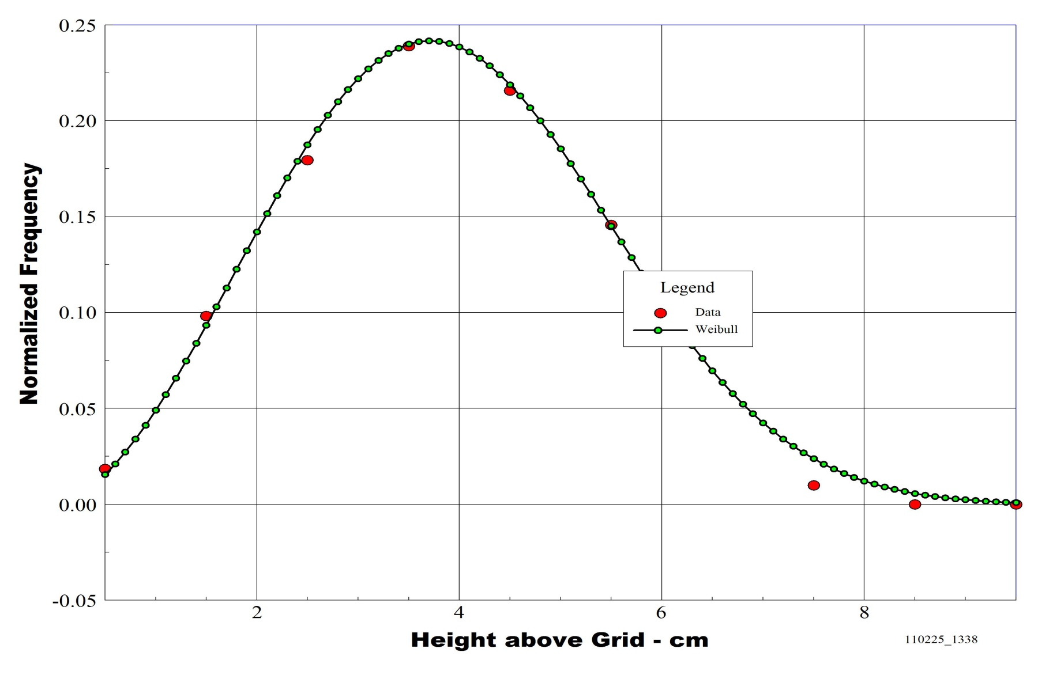
Example comparison of axial tracer pdf to Weibull distribution
0.89 g/cc tracer , U/Umf=1.5

Slide 17
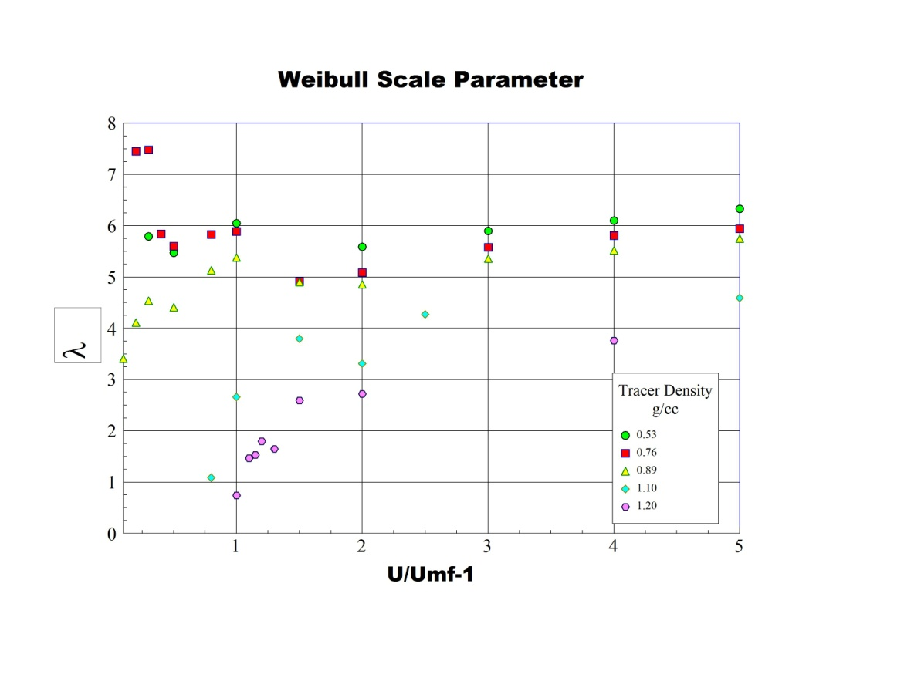
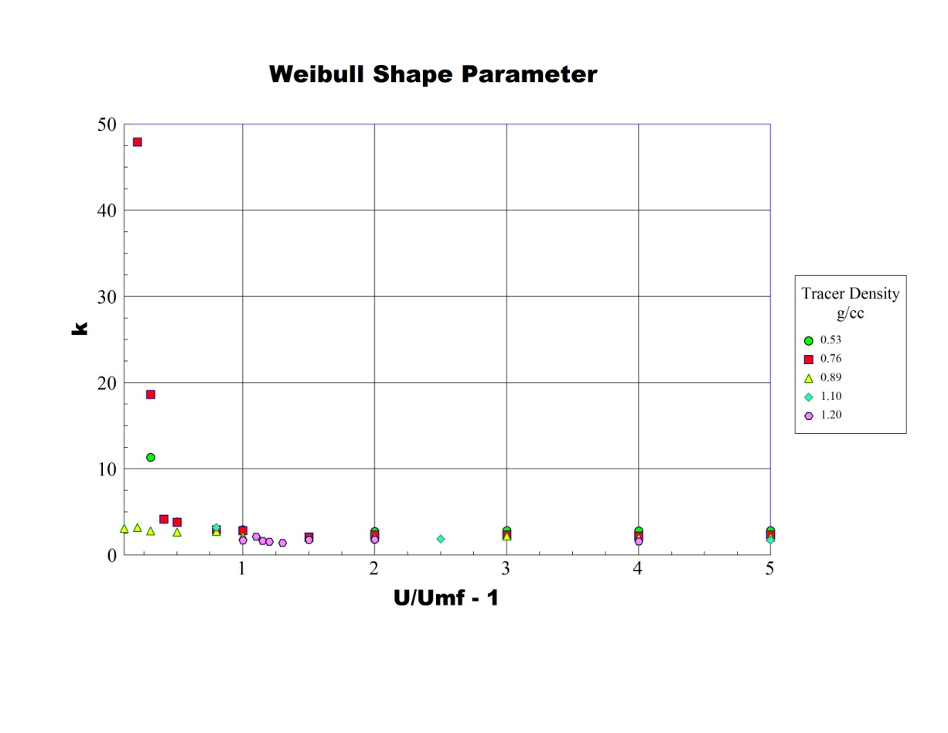
Weibull Parameters Vary with Velocity and Tracer Density

Slide 18
Dynamic particle modeling (1)
Objectives:
  Develop simple Monte Carlo models that replicate key temporal and statistical features of tracer particle motion
  Use models to characterize global and local experimental particle trajectories and mixing patterns
  Apply simple models to supplement computational models (e.g., CFD, DEM)
  Correlate/interpolate experimental data
  Relate observed patterns to physics
  Make rapid statistical estimates

Slide 19
Dynamic particle modeling (2)
Static nonlinear Transform and Auto-Regression (STAR) model
Static nonlinear transform
  z’ = f(z)
  f = transform Weibull distributed z to Gaussian distributed z’
Linear auto-regression with Gaussian noise
  z’(t) = transformed particle axial location at time t
  τ = sampling time interval
  i = number of time steps into past
  z’(t-τi) = transformed particle location at previous time t-τi
  a_{i} = i th linear regression coefficient
  N(0,σ²) = Gaussian random noise with mean 0, variance σ²
Monte Carlo realization and inverse static nonlinear transform
  Generate z_{MC}’(t) from auto-regression model and N(0,σ²)
  z_{MC} = g(z_{MC}’)
  g = inverse transform: Gaussian z_{MC}’ to Weibull z_{MC}

Slide 20
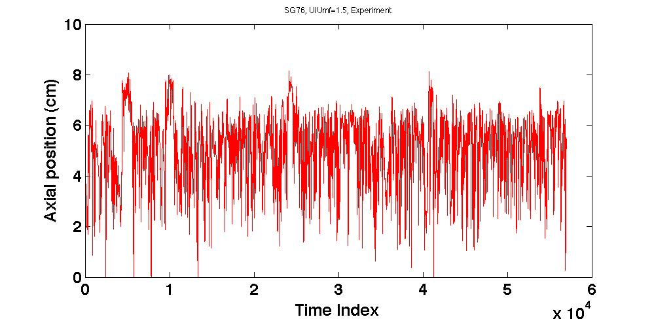
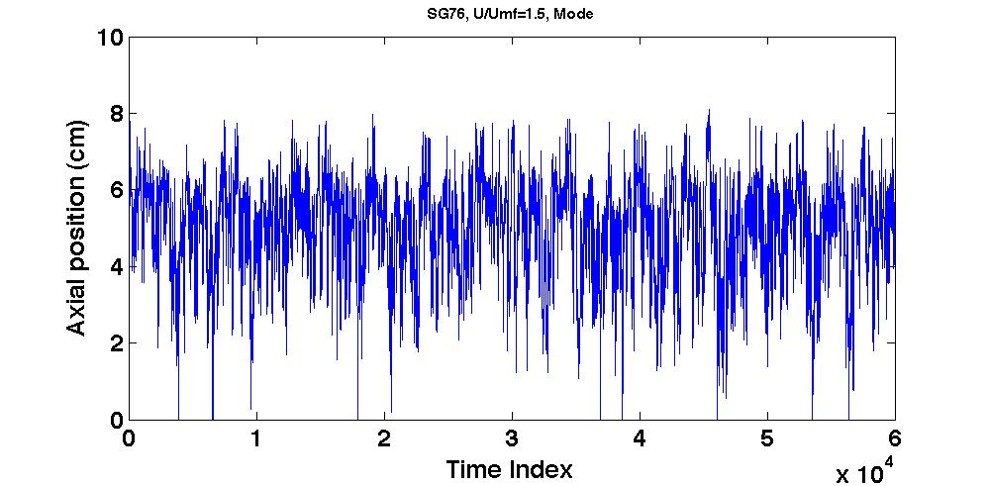
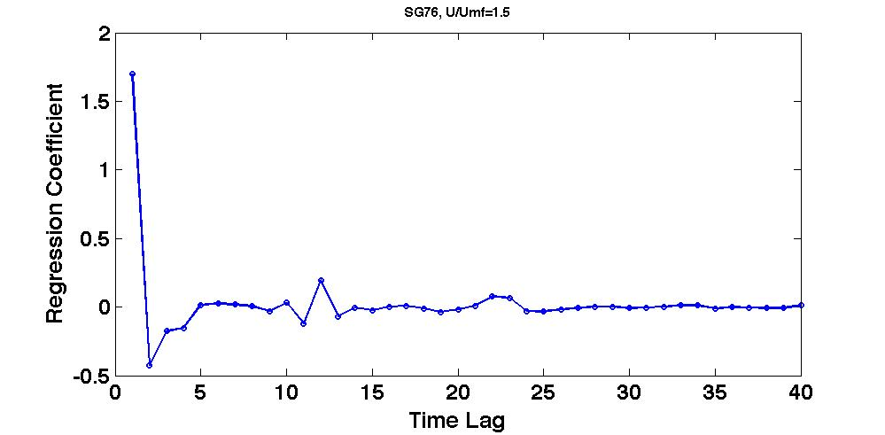
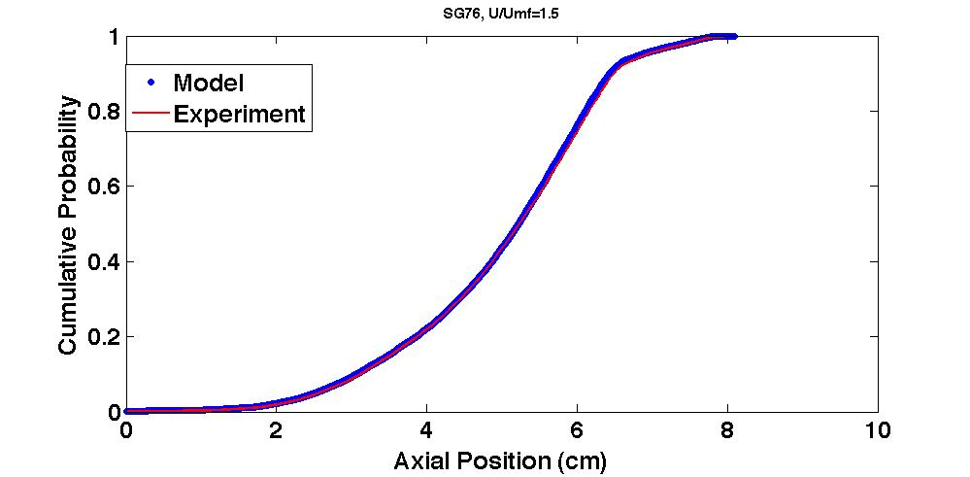
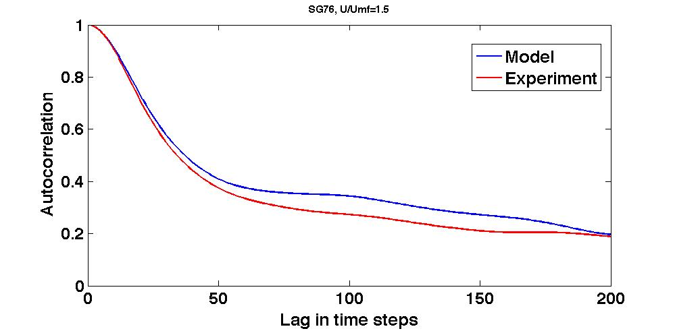
Dynamic particle modeling (3)
STAR model for mildly segregating particle trajectories
Experimental
Monte Carlo Model
SG = 0.76
U/U_{mf} = 1.5
Linear Auto-Regression
Axial Probability Distribution
Autocorrelation Function

Slide 21
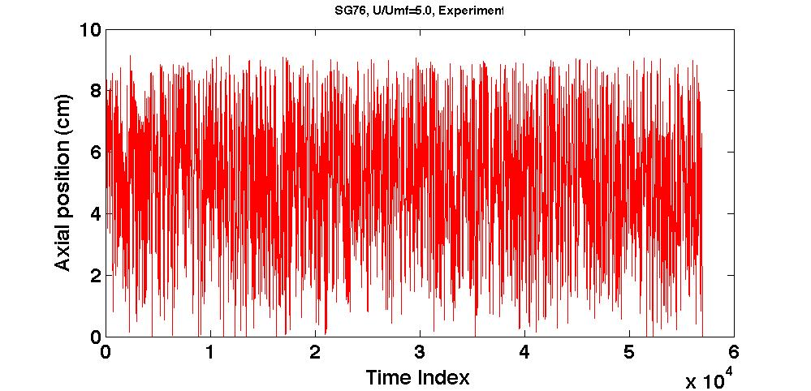
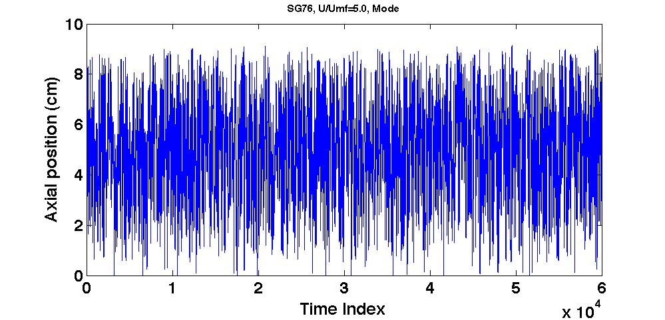
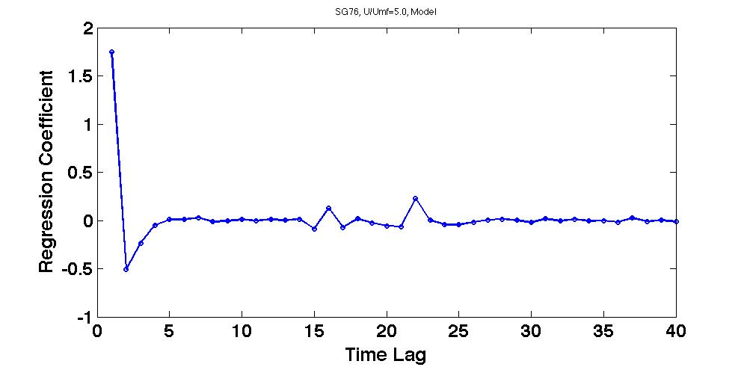
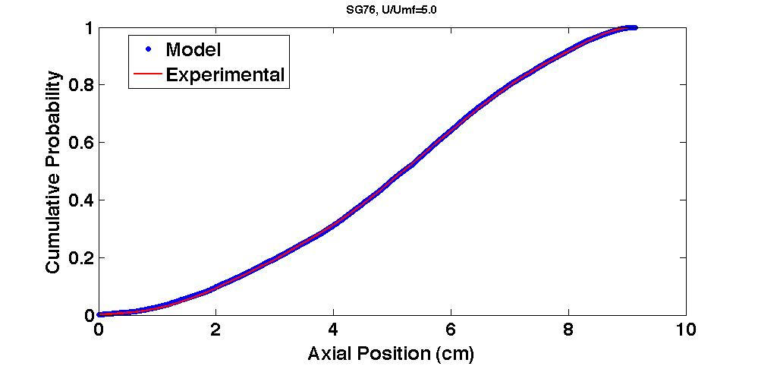
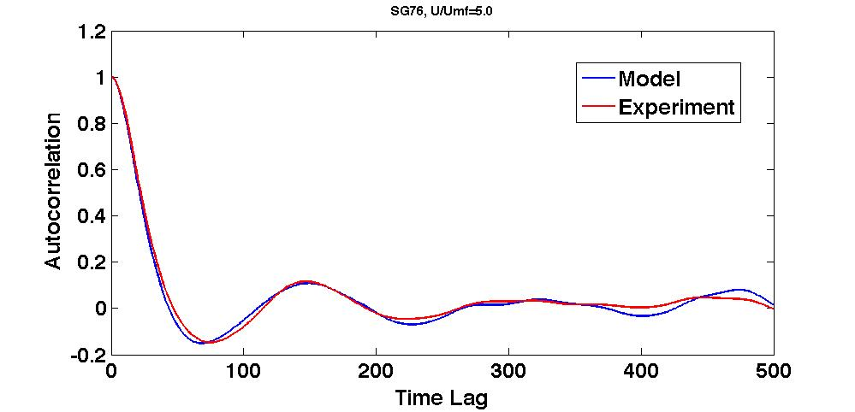
Dynamic particle modeling (4)
STAR model of highly mixed particle trajectories
Experimental
Monte Carlo Model
SG = 0.76
U/U_{mf} = 5.0
Linear Auto-Regression
Axial Probability Distribution
Autocorrelation

Slide 22
Dynamic particle modeling (5)
Plans for future MC modeling studies
  Evaluate models based on nonlinear autocorrelations and non-Gaussian noise
  Evaluate symbolic models (symbolic wavelets)
  Compare model predictions with expanded experimental data and develop correlations
  Compare model predictions with CFD and DEM results
  Relate observed patterns to physics
  Apply estimates to specific process development issues (e.g., optimal reactor injection locations for biomass particles)

Slide 23
Summary
Magnetic particle tracking can provide highly detailed information about the motion of single particles (>1 mm) in bubbling fluidized beds.
Low density biomass particles of 1-5 mm in 200 micron glass beads exhibit significant segregation for U/U_{mf}<2 and nearly complete mixing for U/U_{mf}>3.
The time-average axial locations of simulated biomass particles appear to be approximately described by a Weibull distribution.
The distribution of simulated biomass particle velocities also appears to be non-Gaussian.
It is possible to model particle motion as a nonlinear auto-regressive process with stochastic inputs.

Slide 24
Publications
E. Patterson, J. Halow, and S. Daw, “Innovative Method Using Magnetic Particle Tracking to Measure Solids Circulation in a Spouted Fluidized Bed,” Ind. Eng. Chem. Res. 2010, 49, 5037–5043.
C.S. Daw, J.S. Halow, and C.E.A. Finney, “Modeling spatio-temporal trajectories of individual segregating particles in bubbling fluidized beds,” Manuscript in preparation.
E. Patterson, 237th ACS National Meeting, Salt Lake City, March, 2009.
K. Holsopple, 239th ACS National Meeting, San Francisco, March, 2010.

Slide 25
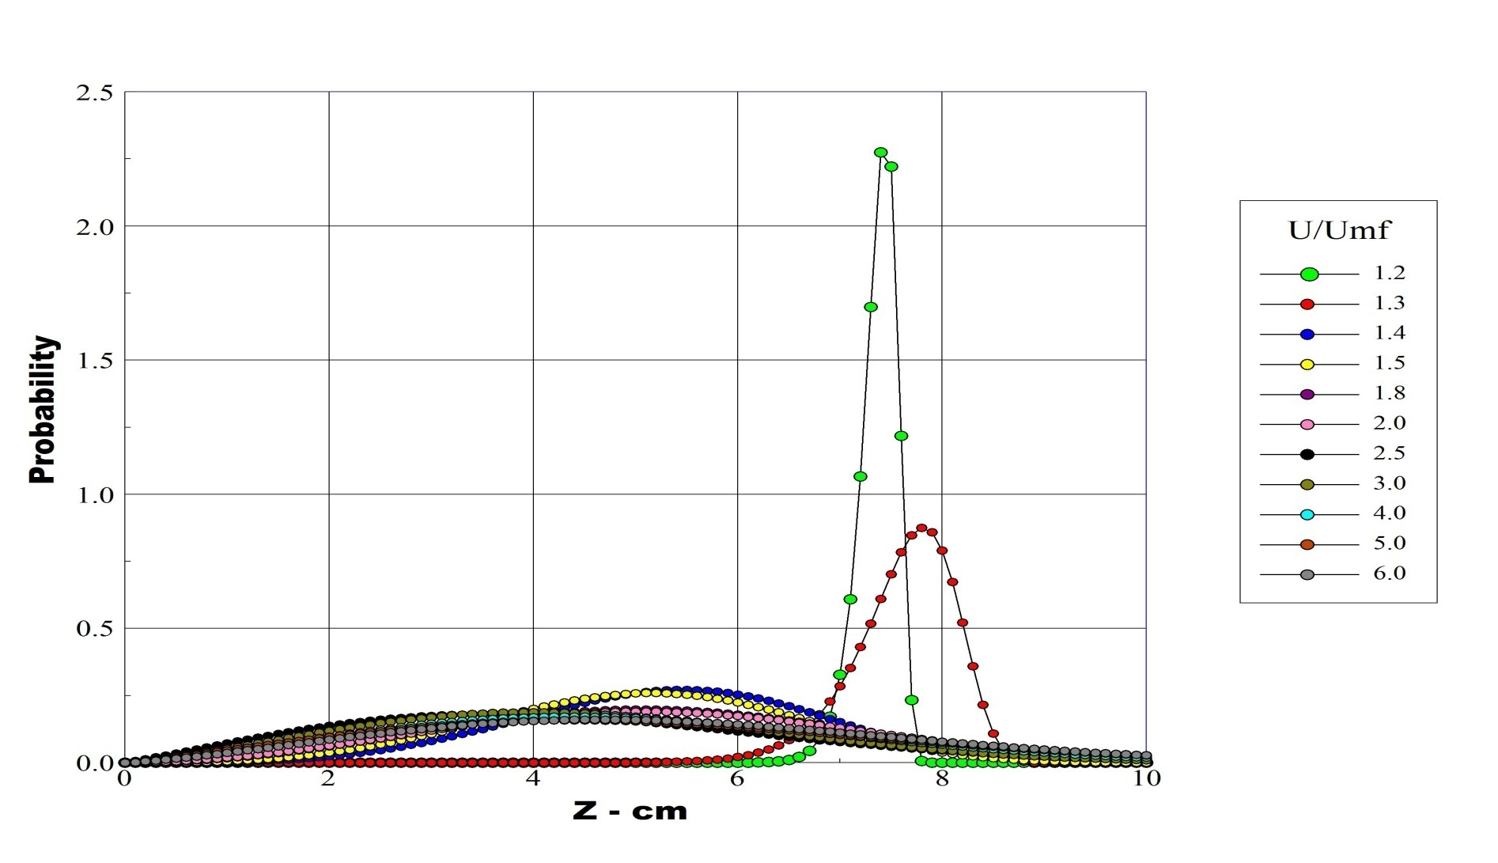
Weibull Distribution with 0.76 g/cc Tracer

Slide 26

Weibull Distribution with 0.89 Tracer

Slide 27
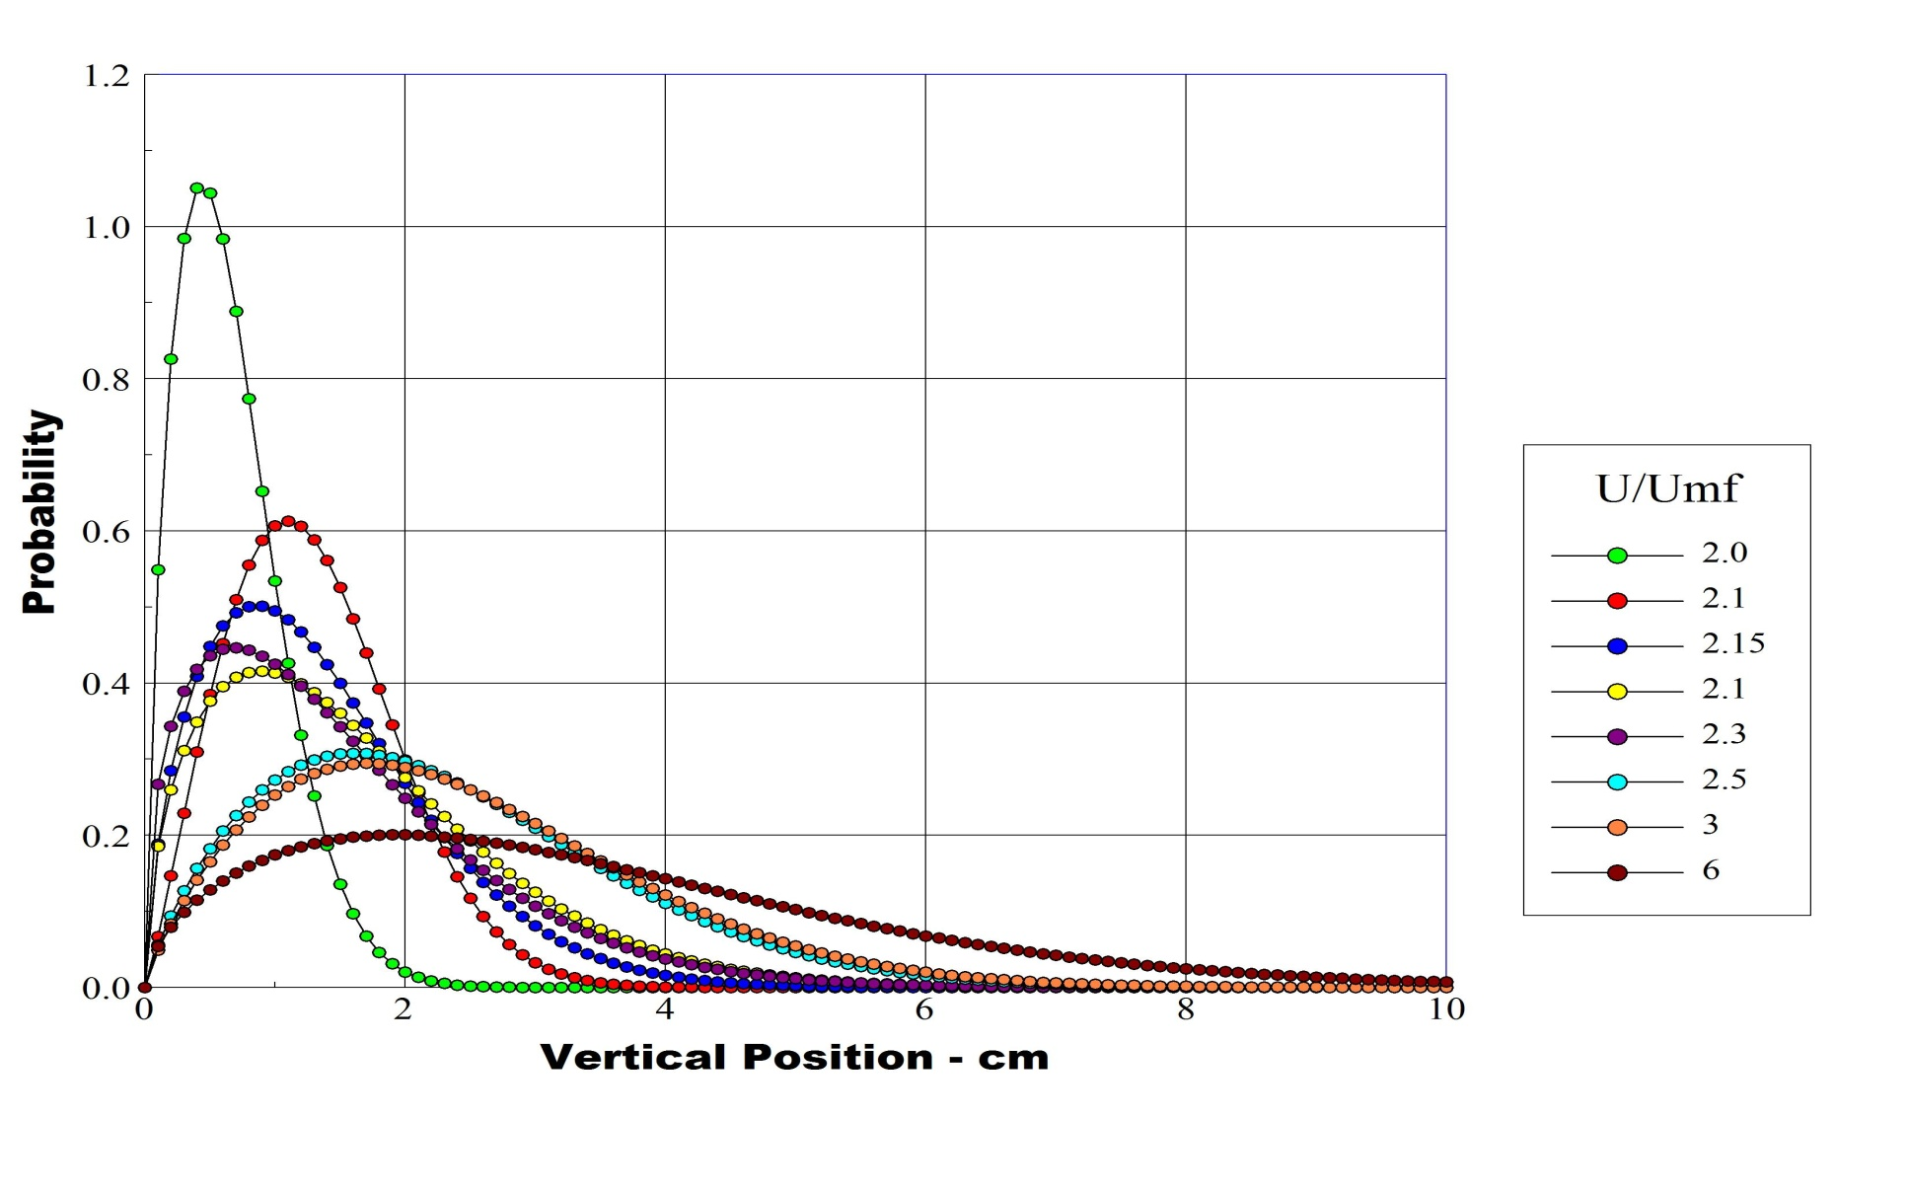
Weibull Distribution with 1.20 Tracer

